Slide 1

moose for dcs world ATC_GROUND (GND)

Slide 2
What is ATC GROUND?
Guard ground operations at airbases and take preventive actions for players not behaving or not following the rules

Slide 3
ATC_gROUND_... class
Currently
Later
Guard player manoeuvres:
Provide warnings to the players who are speeding on the taxi way.
Kick players who are speeding while taxiing on the taxi way.
Kick players who are driving on bare ground (beside the taxi way).
Allow takeoff on the runway.
Kick players who are taking off on the taxi way.
Functionalities:
Guard a respectful distance between planes on the taxi way.
Kick players crashing into other planes and avoid collision situations.
Provide additional information while taxiing to the runway direction.
Add APC operations (maybe in an other class).
Finite State Machine implementation.

Slide 4
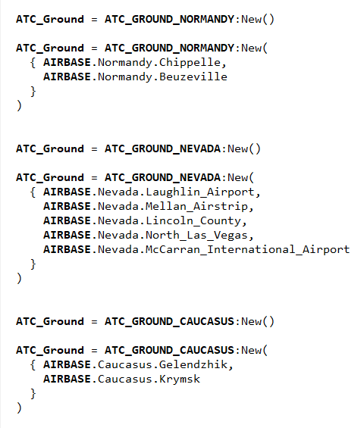
“script it”
Script Examples
ATC_GROUND_NORMANDY
ATC_GROUND_NEVADA
ATC_GROUND_CAUCASUS
:New()
No parameter: Guard all airbases
With list of airbases: Guard specific airbases
AIRBASE.Normandy, AIRBASE.Nevada, AIRBASE.Caucasus

Slide 5
MULTI PLAYER
DCS BUG: MULTIPLAYER WORKAROUND!
DCS WORLD has a series of bugs that are in the system now for years since 1.5 was released. One of these bugs is that when a player connects from a client plane to a server mission, the SSE cannot “destroy” upon command the client plane anymore.
As a workaround, the “Simple Slot Blocker” script of Ciribob has been enhanced to accomodate the kicking of the players from the server. MOOSE talks with “Slot blocker” to kick players, and it works, and it is even a better solution than the previous one, because slots and players can now be permanently banned if necessary.
CLIENT
PLAYER
Kick not working
Kick works!
SERVER
MISSION
SSE
GUI
MOOSE
SSB

Slide 6
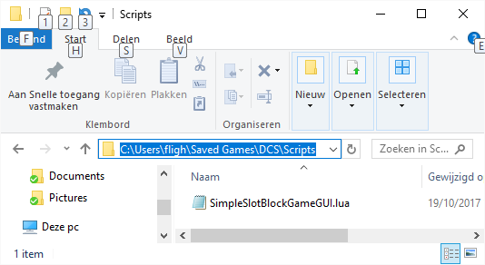
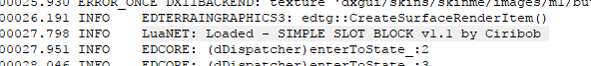
slot blocker installation is easy!
Download the file SimpleSlotBlockerGameGUI.lua
From the ED forums. Search “Simple Slot Blocker” from Ciribob.
From GITHUB: https://github.com/ciribob/DCS-SimpleSlotBlock
From the MOOSE Documentation Site on ATC_Ground
Install the script by copying the SimpleSlotBlockerGameGUI.lua to your user folder “Saved Games/DCS/Scripts”.
Restart DCS and the Slot Blocker should be loaded. You can check the dcs.log file if the script is indeed loaded! A line will appear in the dcs.log file that the “SIMPLE SLOT BLOCK v1.1 by Ciribob” has been loaded. Players will be kicked who don’t behave!

